Slide 1

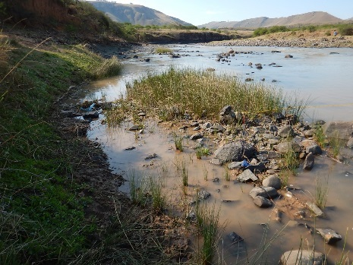

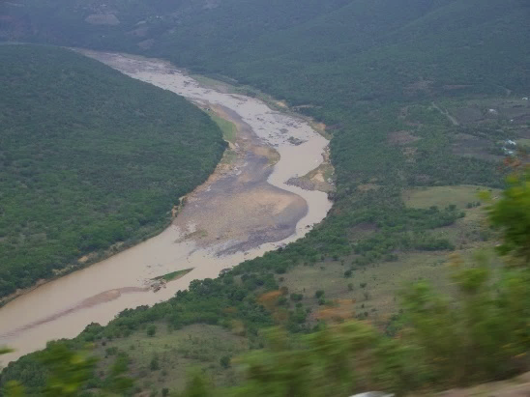
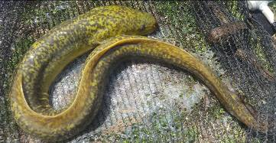
WP 11004: PSC MEETING 3,
13 FEBRUARY 2018
PRESENTATION TITLE
Presented by:
Name Surname
Directorate
Date
DETERMINATION OF WATER RESOURCE CLASSES AND RESOURCE QUALITY OBJECTIVES FOR THE WATER RESOURCES IN THE MZIMVUBU CATCHMENT:
CONSEQUENCES ON ECOSYSTEM SERVICES
Greg Huggins

Slide 2
PROJECT PLAN

Slide 3
SOCIO-ECONOMICS
Looking at the value of water and measure impact of scenarios.
Although they are integrated there are two fundamental pieces of work applied.
Look at value of water abstracted and express the return on utilisation - this can be expressed in Rands and in terms of jobs.
Look at value of water that remains in the system and what this means for utilization of associated goods and services. This is expressed as an order of magnitude impact of scenarios against a status quo reference point.

Slide 4
WHAT ARE ECOSYSTEM SERVICES
Ecosystem Services (previously called EGSAs) are the goods and services provided by the river (and associated ecological systems) that result in a value being produced for consumers.
Provisioning services = ecosystem ‘goods’, such as foods, fuels, fibres, medicine, etc., that are in many cases directly consumed.
Other services include:
  cultural services (ritual use of rivers, aesthetic or historical importance)
  regulating services (e.g. water quality inputs), and
  supporting services (e.g. nutrient formation)

Slide 5
METHODS
For the Mzimvubu Catchment, the following methods were used to generate a picture of the most important Ecosystem Services that are associated with the riverine system and may be subject to change under a potential range of operational scenarios.
  Literature survey
  Census information
  Analysis of maps and Google Earth images
  Interviews in the catchment where priorities were identified.

Slide 6
PROCESS
Evaluate changes to Ecosystem Services against scenarios in expert workshop format.
The specialists (biophysical) identify the potential change that each of the key Services may undergo.
The potential change is used as a factor in later calculations. For example,, no change = 1, a 50% increase = 1.5, and a 20% decrease = 0.8.
E.g.: Each river reach, estuary, and each scenario are analysed to determine how Services may react.

Slide 7
DETERMINING ECOSYSTEM SERVICES CONSEQUENCES OF SCENARIOS
Supporting
Supporting
Cultural
Cultural
Regulating
Regulating
Consequences
Consequences
Provisioning
Provisioning
Model scenarios
PREDICT CONSEQUENCES
Ecosystem Services Status quo
Provide score to indicate relative change from present
Identify specific Services
Above process undertaken for:
Each reach represented by EWR site &
Each scenario
THEN INTEGRATED (USING A WEIGHTED SYSTEM) TO PROVIDE A SYSTEMS CONSEQUENCE

Slide 8
ECOSYSTEM SERVICES SCENARIO SCORING FOR MZIMEWR 1
Services |  | Sc 2a, 2b, 32, 33 | Sc 41, 42, 51, 52, 53 | SC 54 | Sc 2c, 61 | Sc 62,63 | Sc 65 | Sc 69, 70
Provisioning | Normative Score | 0,83 | 1,04 | 1,04 | 0,73 | 0,92 | 1,00 | 0,96
Regulating |  | 0,54 | 1,03 | 1,03 | 1,11 | 1,04 | 1,01 | 1,06
Cultural |  | 0,92 | 1,02 | 1,02 | 0,88 | 0,88 | 0,80 | 0,80
Supporting |  | 0,70 | 0,84 | 0,84 | 0,60 | 0,64 | 0,85 | 0,66
Provisioning | Weighted Score | 0,33 | 0,42 | 0,42 | 0,29 | 0,37 | 0,40 | 0,38
Regulating |  | 0,11 | 0,21 | 0,21 | 0,22 | 0,21 | 0,20 | 0,21
Cultural |  | 0,23 | 0,26 | 0,26 | 0,22 | 0,22 | 0,20 | 0,20
Supporting |  | 0,11 | 0,13 | 0,13 | 0,09 | 0,10 | 0,13 | 0,10
Total |  | 0,77 | 1,00 | 1,00 | 0,83 | 0,89 | 0,93 | 0,90

Slide 9
ECOSYSTEM SERVICES SCENARIO SCORING FOR MZIMEWR 4
Services |  | Sc 2a, 2b | Sc 32, 33, 41, 42, 51 | Sc 52 | Sc 53 | Sc 2c, 61 | Sc 62 | Sc 63 | Sc 65 | Sc 69,70
Provisioning | Normative Score | 1,02 | 1,02 | 1,02 | 1,06 | 0,88 | 0,94 | 0,94 | 0,99 | 1,06
Regulating |  | 1,07 | 1,09 | 1,09 | 1,04 | 1,10 | 1,04 | 1,06 | 1,06 | 1,06
Cultural |  | 1,06 | 1,06 | 1,06 | 1,10 | 1,06 | 1,10 | 1,10 | 1,10 | 1,10
Supporting |  | 0,89 | 0,89 | 0,89 | 1,00 | 0,88 | 0,90 | 0,90 | 0,95 | 0,95
Provisioning | Weighted Score | 0,41 | 0,41 | 0,41 | 0,43 | 0,35 | 0,38 | 0,38 | 0,40 | 0,42
Regulating |  | 0,21 | 0,22 | 0,22 | 0,21 | 0,22 | 0,21 | 0,21 | 0,21 | 0,21
Cultural |  | 0,27 | 0,27 | 0,27 | 0,28 | 0,27 | 0,28 | 0,28 | 0,28 | 0,28
Supporting |  | 0,13 | 0,13 | 0,13 | 0,15 | 0,13 | 0,14 | 0,14 | 0,14 | 0,14
Total |  | 1,02 | 1,02 | 1,02 | 1,06 | 0,97 | 1,00 | 1,00 | 1,03 | 1,05

Slide 10
ECOSYSTEM SERVICES SCENARIO SCORING FOR EWR1 LALINI
Services |  | Sc 2a, Sc 2b, Sc 41, Sc 51, Sc 53 | Sc 33, Sc 42, Sc 52. | SC 61, 63, 65 , 69 | Sc 54 | SC 2c, 70
Provisioning | Normative Score | 0,71 | 1,00 | 0,80 | 0,80 | 0,71
Regulating |  | 0,54 | 0,97 | 0,80 | 0,80 | 0,54
Cultural |  | 0,84 | 1,00 | 0,80 | 0,80 | 0,20
Supporting |  | 0,70 | 0,85 | 0,80 | 0,80 | 0,70
Provisioning | Weighted Score | 0,28 | 0,40 | 0,32 | 0,32 | 0,28
Regulating |  | 0,11 | 0,19 | 0,16 | 0,16 | 0,11
Cultural |  | 0,21 | 0,25 | 0,20 | 0,20 | 0,05
Supporting |  | 0,11 | 0,13 | 0,12 | 0,12 | 0,11
Total |  | 0,71 | 0,97 | 0,80 | 0,80 | 0,55

Slide 11
ECOSYSTEM SERVICES SCENARIO SCORING FOR MZIMVUBU ESTUARY
 |  | Sc 53=Sc 54 | Sc 61 | Sc 62 | Sc 63 | Sc 65 | Sc 69
Provisioning | Normative Score | 1,00 | 1,00 | 1,00 | 1,00 | 1,00 | 1,00
Regulating |  | 0,99 | 0,99 | 1,01 | 0,99 | 0,99 | 0,99
Cultural |  | 1,00 | 1,23 | 1,20 | 1,23 | 1,25 | 1,25
Provisioning | Weighted Score | 0,20 | 0,20 | 0,20 | 0,20 | 0,20 | 0,20
Regulating |  | 0,39 | 0,39 | 0,41 | 0,39 | 0,39 | 0,39
Cultural |  | 0,40 | 0,49 | 0,48 | 0,49 | 0,50 | 0,50
Supporting
Total |  | 0,99 | 1,08 | 1,09 | 1,08 | 1,09 | 1,09

Slide 12
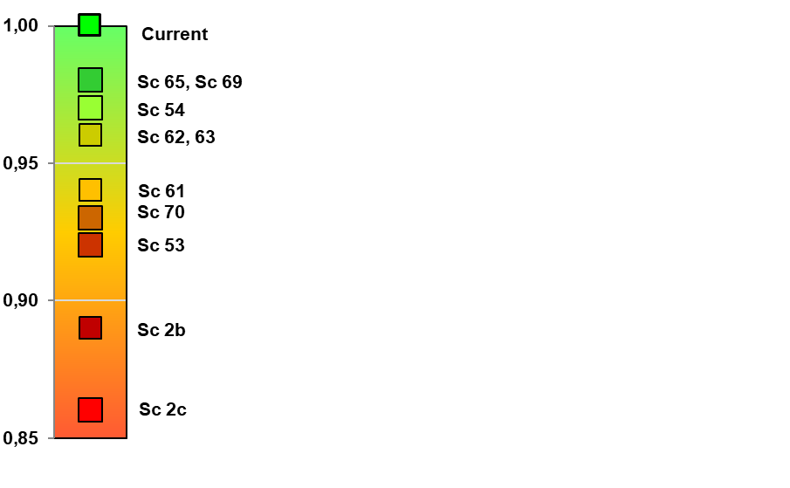
INTEGRATED RESULTS FOR SCENARIOS

Slide 13
CONCLUSIONS
At MzimEWR1 scenarios are mostly negative.
At MzimEWR4 scenarios are mostly marginally positive or neutral.
At EWR1 Lalini scenarios are negative
For the Estuary the scenarios are neutral or marginally positive.
Overall results suggest Sc 65 and Sc 69 show least impact on Ecosystem Services, with Sc 54, Sc 62 and Sc 63 being acceptable.

Slide 14
QUESTIONS FOR CLARIFICATION

